Slide 1

Nutrition for optimum development of the young horse

Slide 2
Overview
Developmental Orthopaedic Disease
Suspected causes
Nutritional implications
Risk at each stage: Pregnancy – Yearling
Feeding actions to reduce risk

Slide 3
Developmental Orthopaedic disease (DOD)
Includes:
Physitis – swelling around growth plates
Osteochondritis Dissecans (OCD) – an interruption in bone development
Wobbler Syndrome – compression of the spinal cord
Angular limb deformity – ‘crooked legs’

Slide 4
SUSPECTED CAUSES OF DOD
Trauma
Genetic predisposition
Restricted exercise
Forced exercise
Rapid growth rates
Excess body condition
Poor nutrition (pregnant mare and young horse)

Slide 5
Nutritional issues
Excess calorie intake:
  Fast growth
  Excess body condition
Mineral deficiencies
Mineral excesses
Mineral imbalances
Key minerals Calcium, Phosphorous, Copper, Zinc.
High carbohydrate feeds

Slide 6
Pregnant Mares
  Early pregnancy minimal increase in nutritional demands
  Last trimester key period in broodmare nutrition
      Demonstrated in Copper research
  Very important to provide adequate mineral intake for foetal liver stores.
  Avoid excessively over weight mares

Slide 7
Practical application to minimise risk of DOD
Utilise:
Feeds formulated for pregnant mares
Feeds must be fed at recommended intakes.
Use concentrates for ‘good doers’
Adding random minerals to feeds can cause imbalances

Slide 8
Foals from 3 months
Require adequate mineral intake
Balanced mineral intake
Quality proteins
Avoid confinement if possible
Avoid excessive growth rates
Introduce feed prior to weaning
Low GI feed option
  Research indicated a high glucose & insulin response to concentrates associated with increase in OCD
  Ideally first feed the foal receives

Slide 9
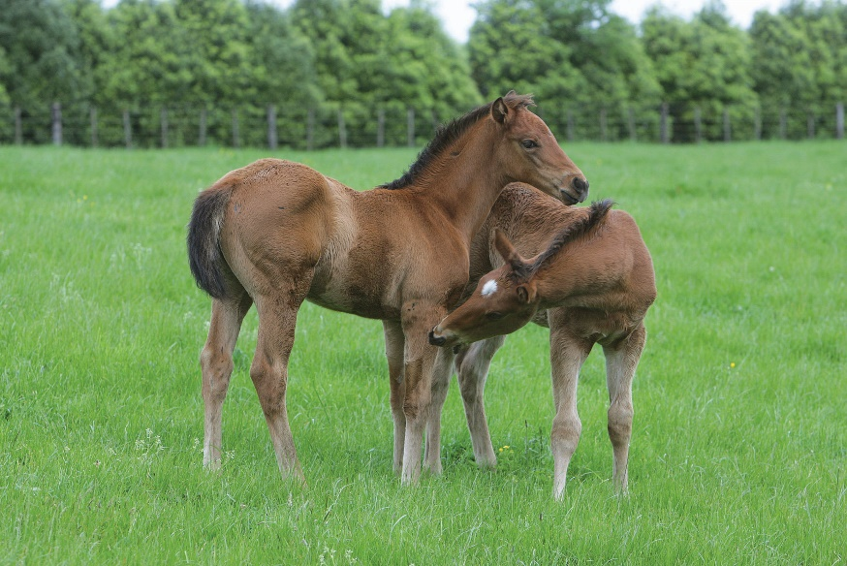
Practical application to minimise risk of DOD
Utilise:
Feeds formulated for purpose
These will have appropriate mineral levels
  These will include quality protein sources
  Wean very good doers early
  Concentrates for ‘good doing’ weanlings
  Low GI Feeds

Slide 10

Weanlings 6-12 months- critical stage
  Adequate mineral supplementation
  Balanced mineral intake
  Avoid excessive calorie intake
  Aiming for moderate growth (rather than rapid)
  Regular weight data can be very useful

Slide 11
YEARLINGS –a safer time
Adequate fibre in the diet (min 1%BW in hay/chaff/pasture daily)
Combination of Low GI and Grain based feeds. (sales prep)
Delay increased energy required for conditioning as long as possible
Managing Physitis – keep mineral intake up and supply more calories from fat and fibre than grain
Addition of high fat supplements for ‘cool’ calories and Coat.
Use blended oils & those with good Omega 3 profile.

Slide 12
Summary
Last Trimester of the mares pregnancy key for mineral fortification of diet
Use premixed feeds at the recommended intakes to ensure adequate vitamin and mineral fortification.
Use concentrates for ‘good doers’ (all horses)
After 3 months of age supplement foals for appropriate mineral intake.
Avoid young horses getting too heavy
Low GI feeds suitable feed option for young horses.

