Slide 1
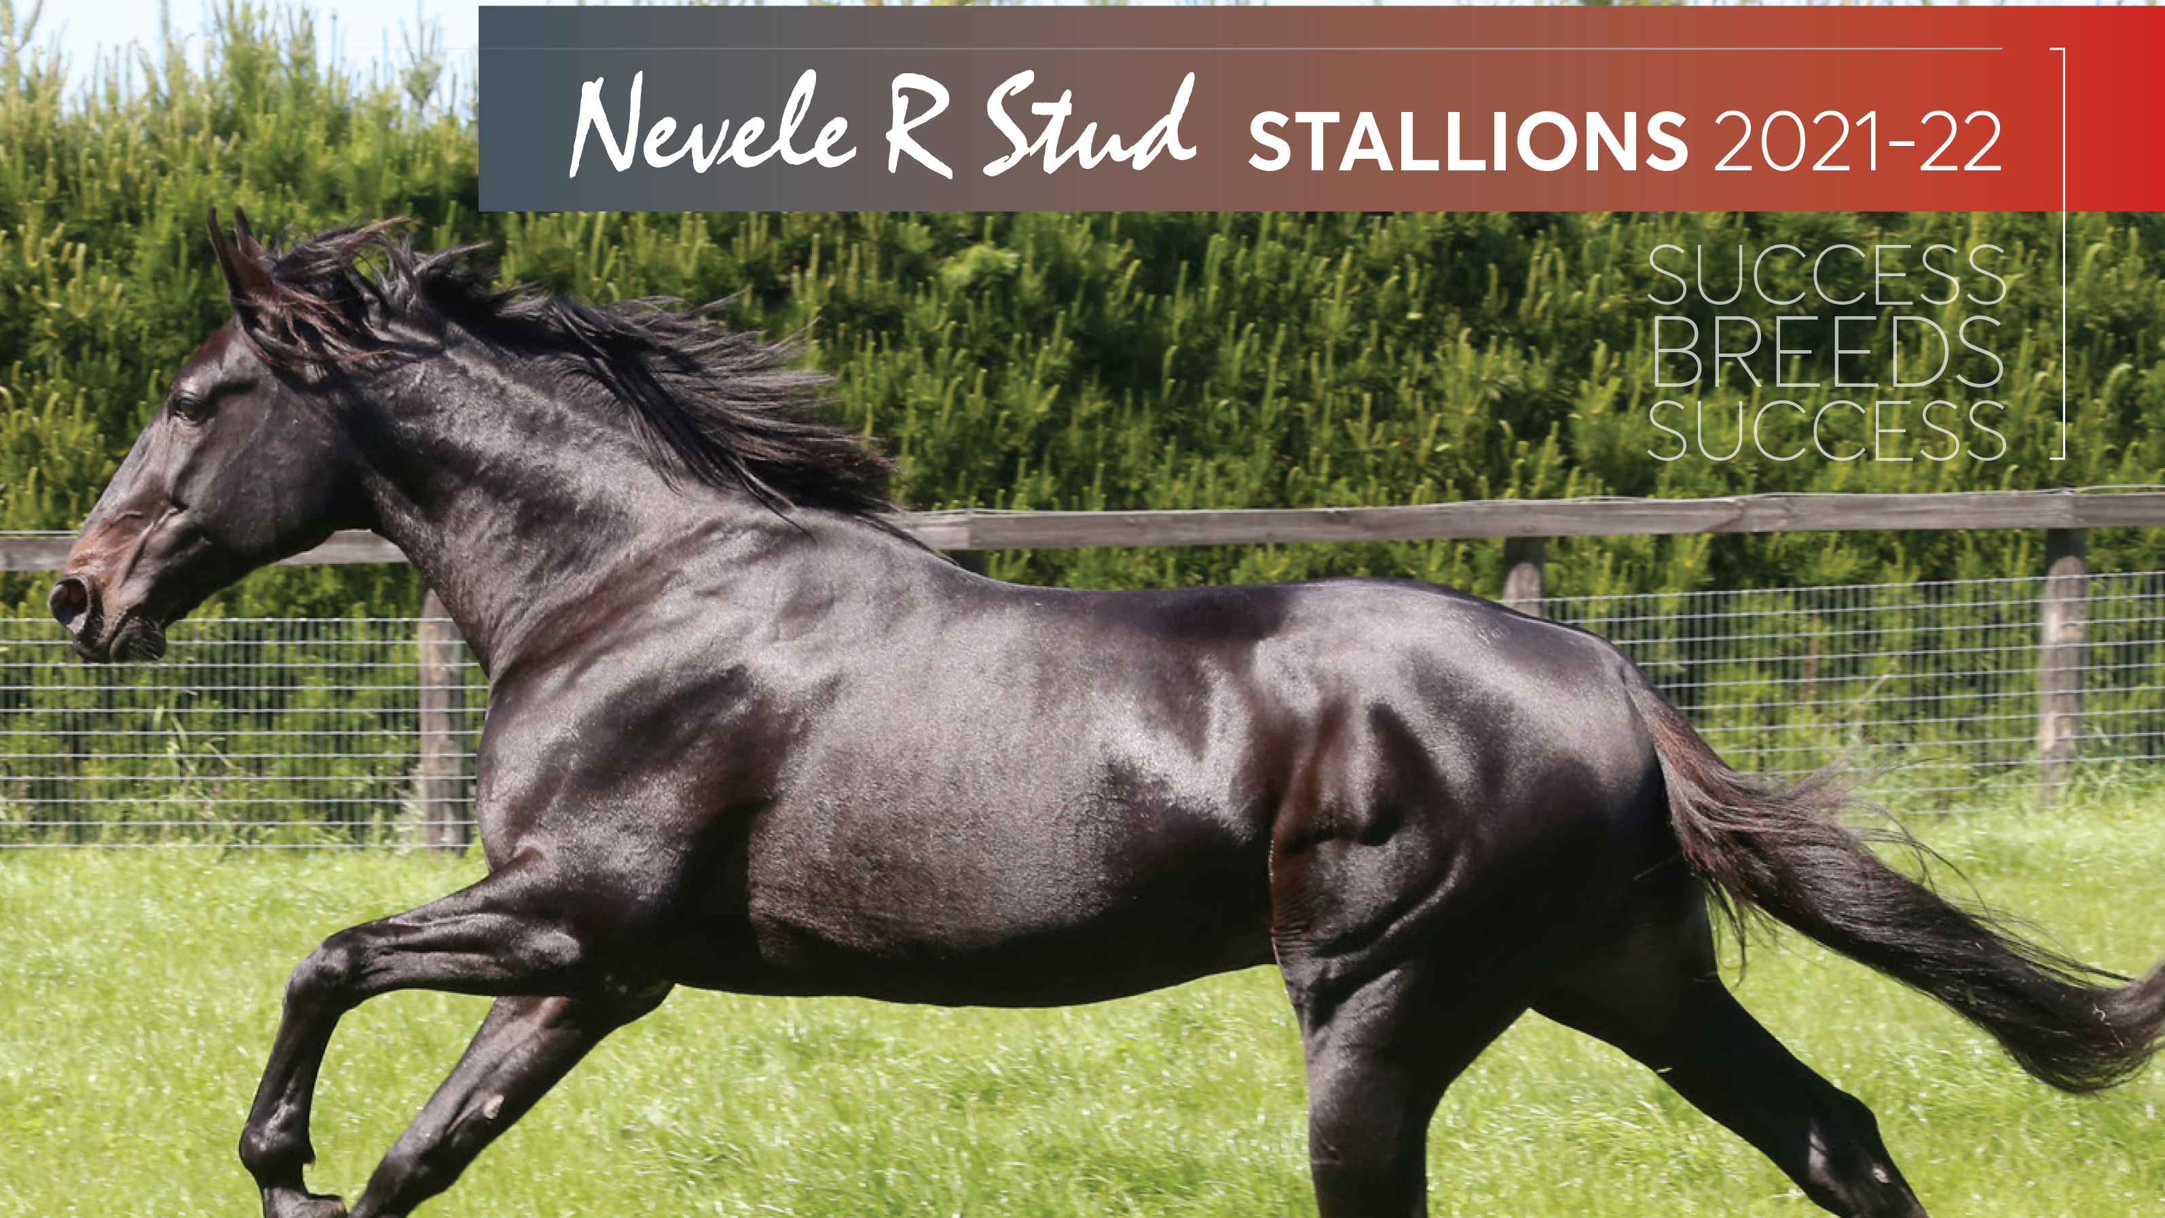

Slide 2
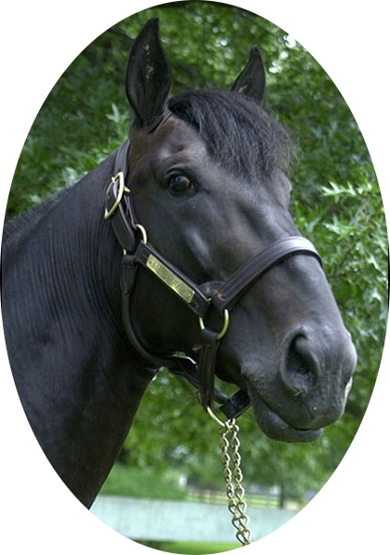
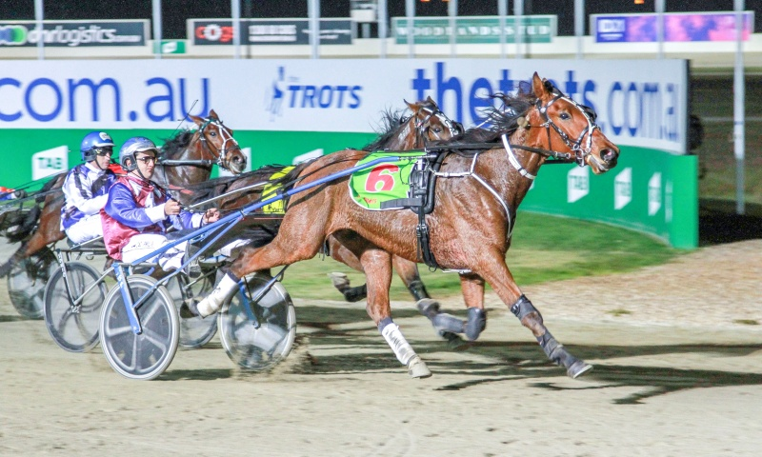
AN INTERNATIONAL TROTTING SIRING COLOSSUS
ANDOVER HALL
FROM TROTTING’S GREATEST MODERN DAY MATERNAL FAMILY
Sire of 12 millionaires worldwide including the $3,000,000+ earning Horses of the Year, Nuncio and Donato Hanover
Dam is in both the US & Canadian Halls of Fame; his pedigree page features Angus Hall, Conway Hall, Emilie Cas El, Trixton, Cameron Hall, Cantab Hall, E L Titan, 2020 US 2YO Trotting Colt of the Year Venerate…
Sire of the multiple Group 1 winner & 2019 Australian 2YO Trotting Filly of the Year Jaxnme, plus top juveniles Is That A Bid & Andover Sun
In 2021, sire of quality NZ performers American Pride, Anditover, Andoverlov and Andy Hall
$4,000 + gst POLF
Is That A Bid – dual Group 1 winner, including the 2020 Vicbred Super Series 3YO Final

Slide 3
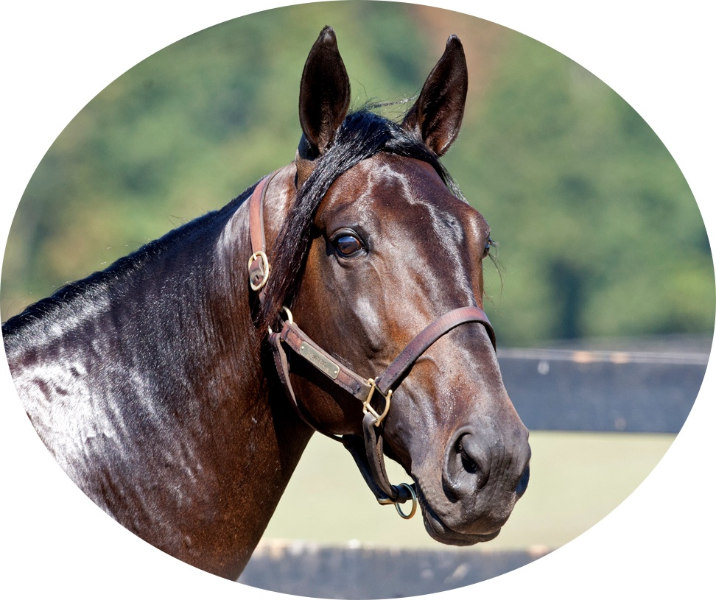
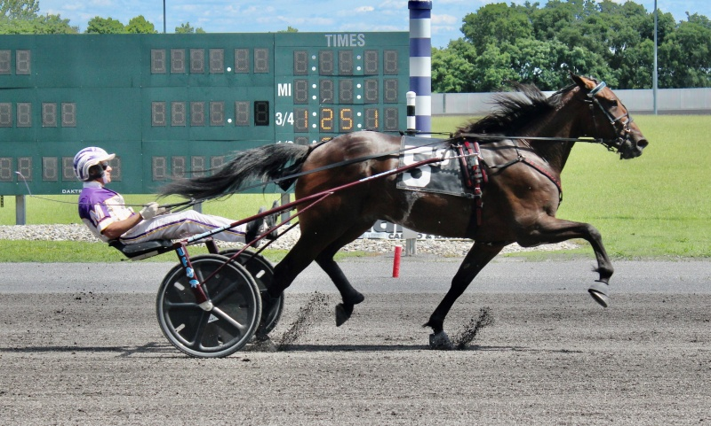
ONE OF THE BEST CREDENTIALLED TROTTING STALLIONS EVER TO STAND IN AUSTRALASIA
CREATINE
NO DOWN-UNDER FRESH SEMEN TROTTING SIRE HAS GONE FASTER, NOR EARNED MORE
An outstanding racehorse, Creatine won US Grand Circuit races every season from the age of two through to five
A Breeders Crown champion & multiple European Group 1 winner
Off to a strong start with his first down-under crop, with multiple 2yo winners in both NZ and Australia (6 winners from 8 starters)
Second crop yearlings sold up to $60,000 in 2021 and averaged more than 8x his service fee across the major Australasian sales
Produced both Grand Circuit & Sires Stakes division winners from his first North American crop (3YOs in 2021)
$3,000 + gst
Take All Comers – Bluegrass Stakes winner and the fastest 2yo trotting gelding in North America in 2020

Slide 4
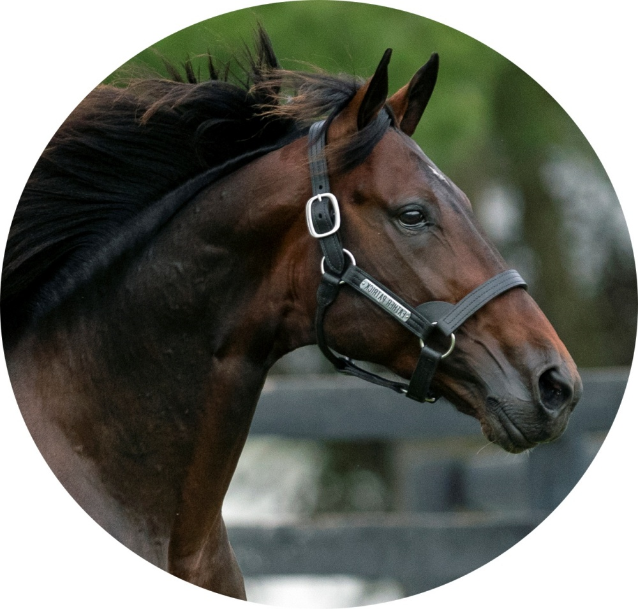
THE BEST TROTTER OF HIS GENERATION AND AN EMERGING SIRING POWERHOUSE
FATHER PATRICK
A RECORD BREAKING YEARLING SALES SIRE IN BOTH HEMISPHERES
A multiple world champion & US 2YO & 3YO Trotting Colt of the Year
Already the sire of six Group 1 performers from his first crop of 38 live foals, including the Group 1 winners Sangreal and Have No Fear
One of today’s most commercial stallions – sire of the most expensive standardbred yearling ever sold (US$1.1million); the highest priced trotting yearling in AUS history ($170,000) & was the leading sire at the 2021 NZB Sale of Trotters, selling up to $120,000
Produced two $1,000,000+ earning US 3YO Male Trotters of the Year from his first two North American crops – Greenshoe & Amigo Volo
$9,000 + gst POLF
Sangreal – 2020 Group 1 Australasian Breeders Crown 2YO Trotting Fillies Final winner

Slide 5
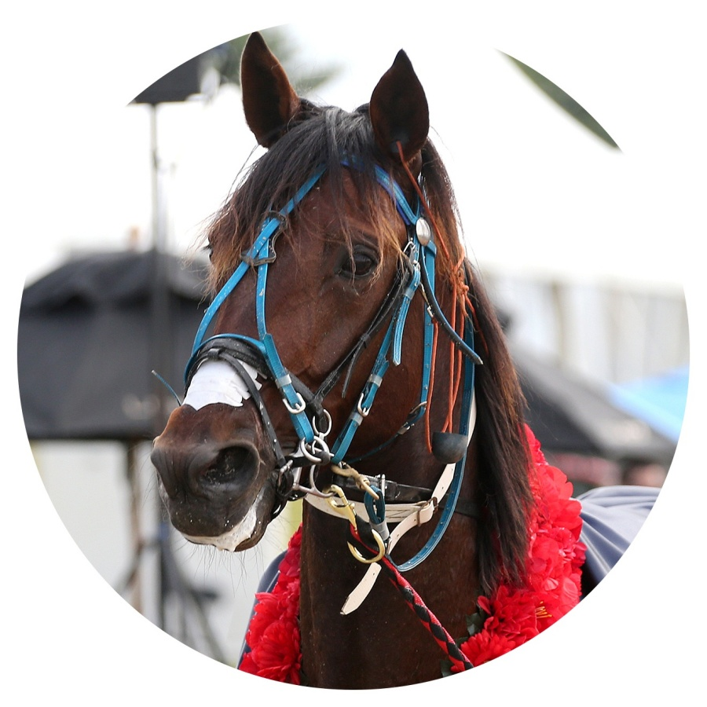
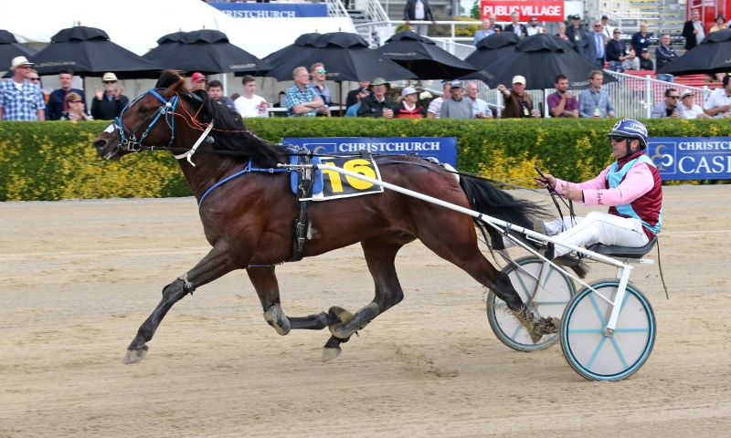
THE RICHEST AND FASTEST ENTIRE SON OF NZ’S GREATEST EVER TROTTING STALLION SUNDON
MARCOOLA
THE NZ TROTTING ALL-COMERS RECORD HOLDER AND THE FASTEST EVER TROTTING STALLION ON AUSTRALASIAN SOIL
A three-time Group 1 winner, including New Zealand’s richest trotting race, the Dominion Handicap
NZ 3YO Trotting Colt of the Year, with a 7 race win streak that included both the NZ & Northern Trotting Derbies
His NZ record in the Ashburton Trotters Flying Mile was one of the most dominant performances by an Open Class trotter in the past decade
By a 16-time NZ Trotting Sire of the Year from a maternal family that has three Dominion Handicap winners in the first three generations including NZ’s greatest ever trotter Lyell Creek
$2,000 + gst
Marcoola – Winning the 2018 Group 1 Dominion Handicap

Slide 6
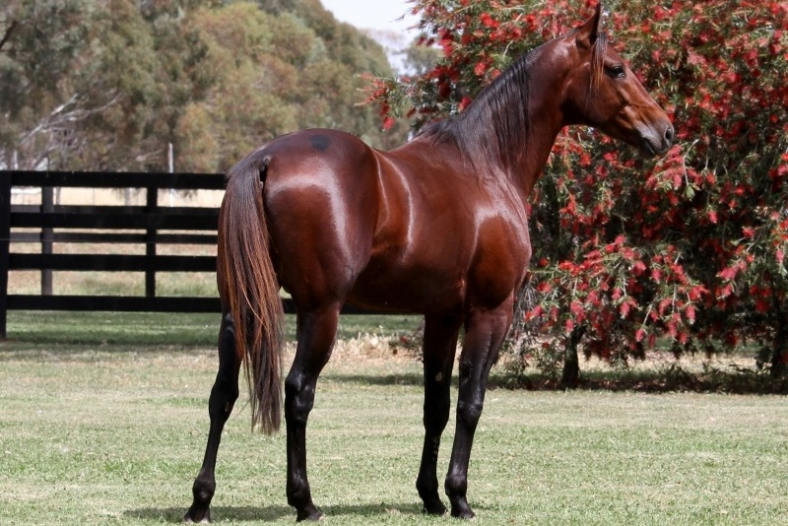
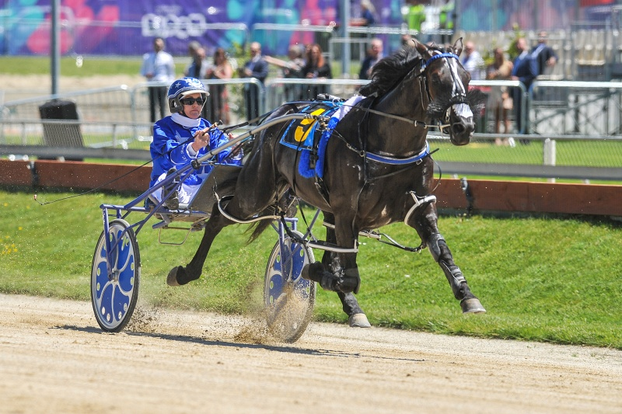
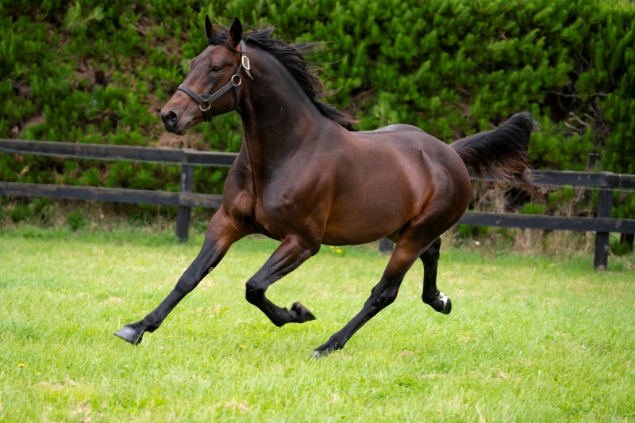
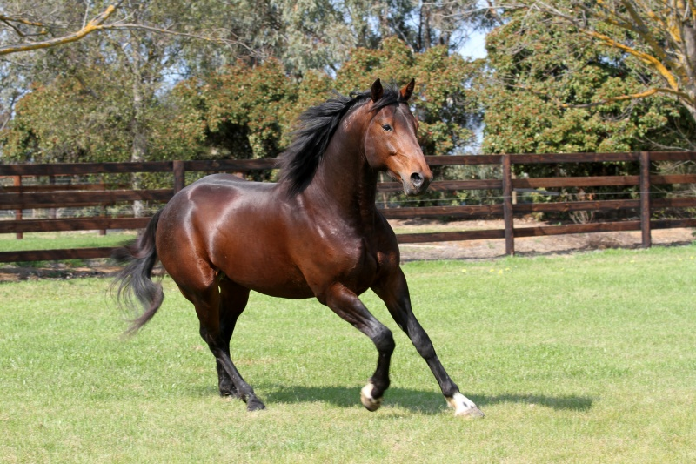
ALSO AVAILABLE IN PARTNERSHIP WITH ALABAR
ALWAYS B MIKI
Off to a sensational start as a sire in both the Southern and Northern Hemispheres
ULTIMATE SNIPER
A 4-time Group 1 winner. NZ 3YO of the Year and reigning Horse of the Year
CAPTAIN CRUNCH
A superstar racehorse and the richest son of Captaintreacherous
VINCENT
A superbly bred young sire whose first yearlings sold up to $215,000 – an Australasian record for a first season sire

Slide 7
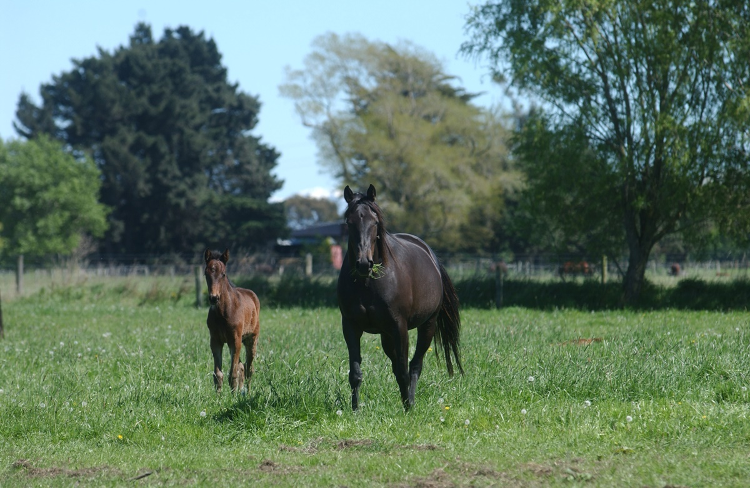
SERVICES AVAILABLE
FOALING – 24 hour foal watch
BREEDING – High in-foal rates. Mares to both Nevele R & Non-Nevele R stallions welcome
FROZEN SEMEN
AGISTMENT
WEANING
YEARLING SALES PREP

Slide 8
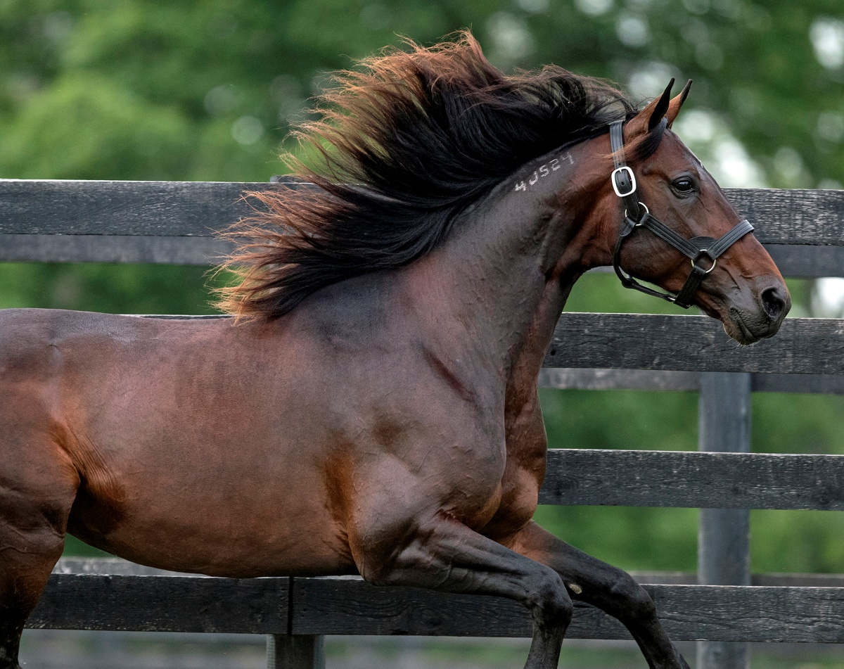
DISCOUNTS
MULTIPLE MARE DISCOUNTS – apply for two or more mares served by any of our stallions
EARLY BIRD DISCOUNT – a 20% discount on our fresh/chilled semen sires for payment by 30 September 2021
Always B Miki, Captain Crunch, Ultimate Sniper and Vincent are included in both the Nevele R and Alabar discount schemes

