Slide 1
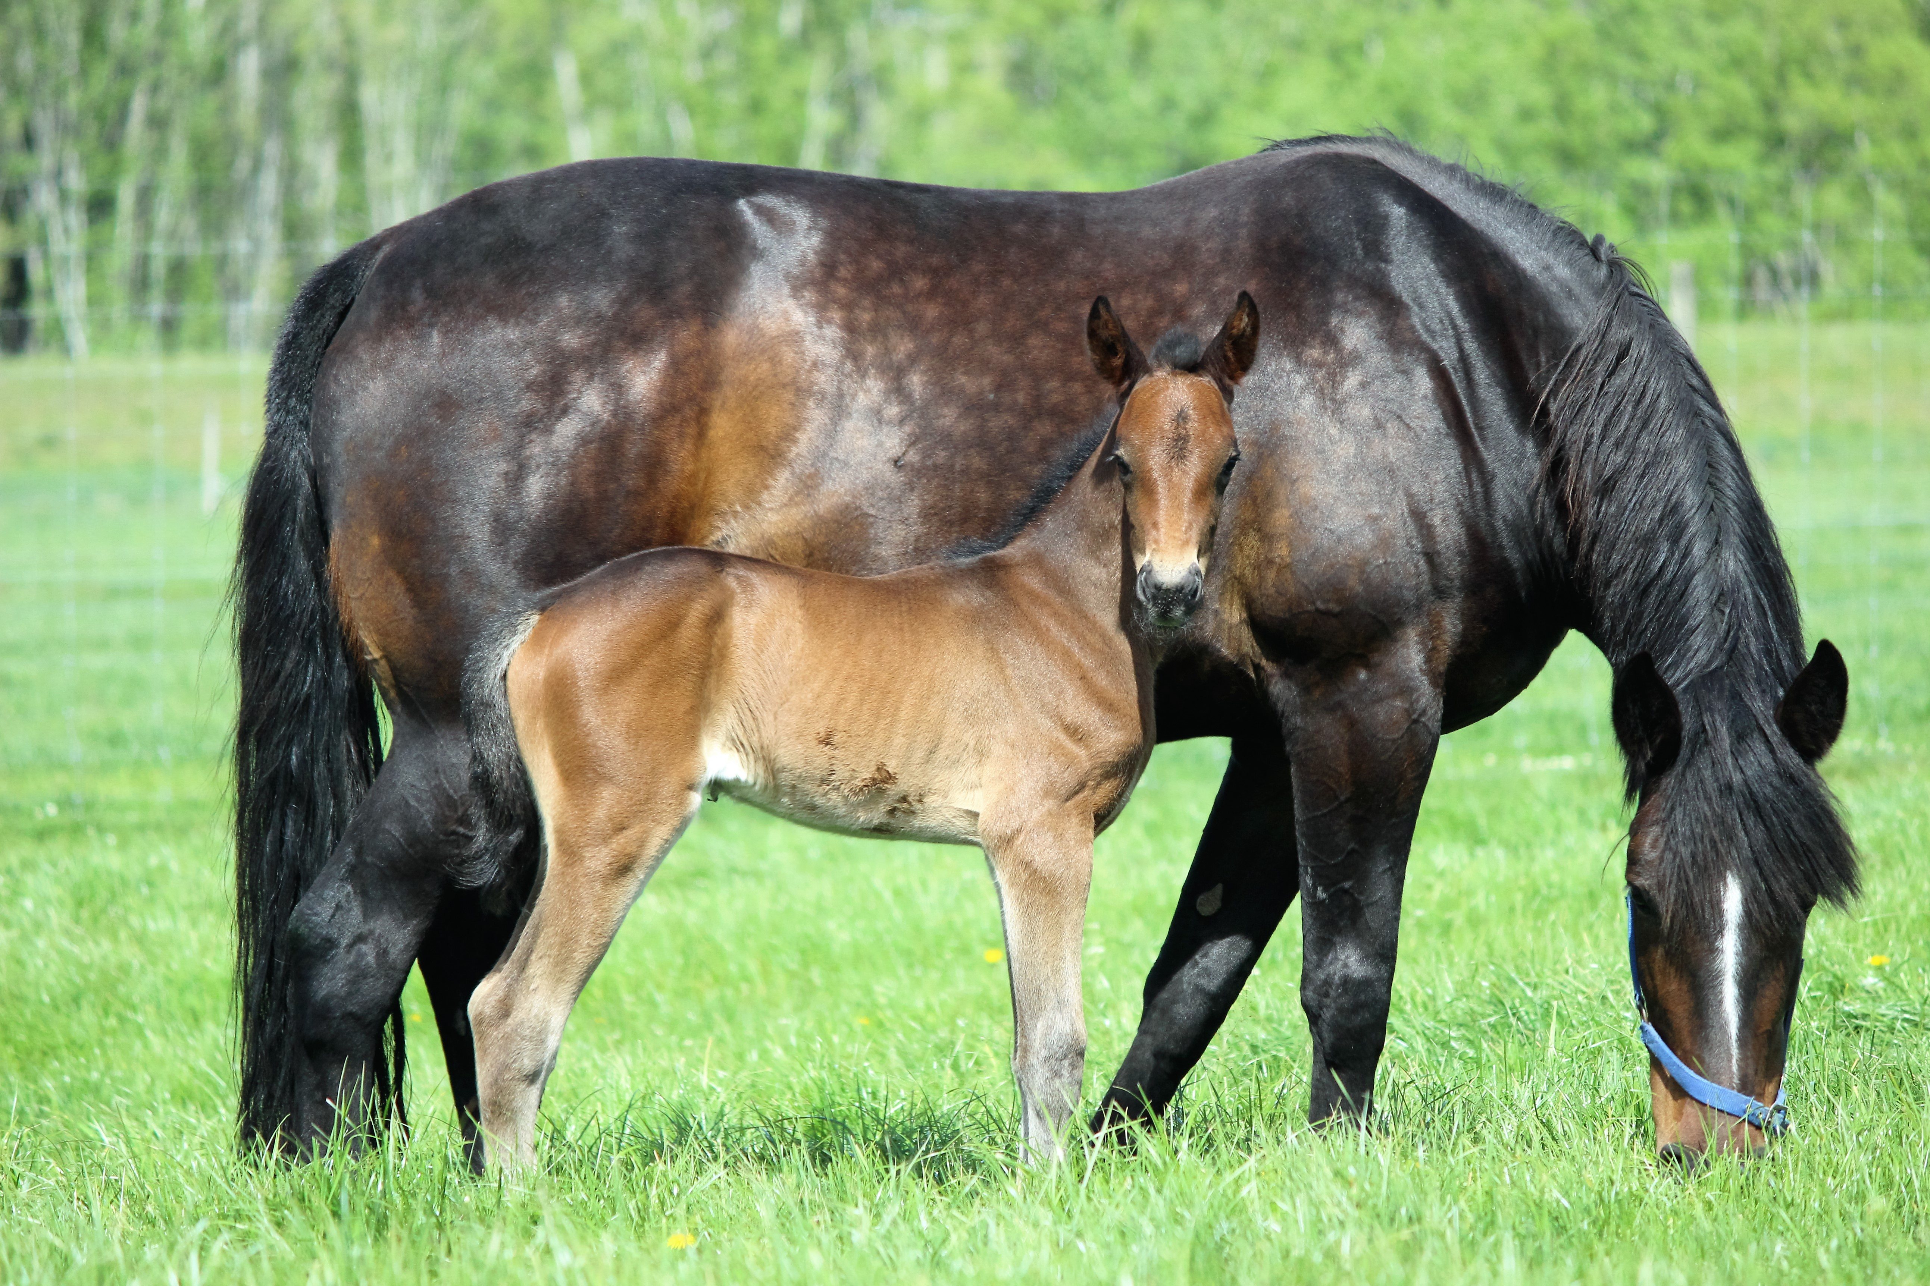

2021-2022
STALLIONS

Slide 2
All our stallions present superb value for breeders.
Still supporting breeders with specials available on
SERVICE FEES this SEASON
Support local owners who are giving their stallions a chance to make it as a sire.

Slide 3
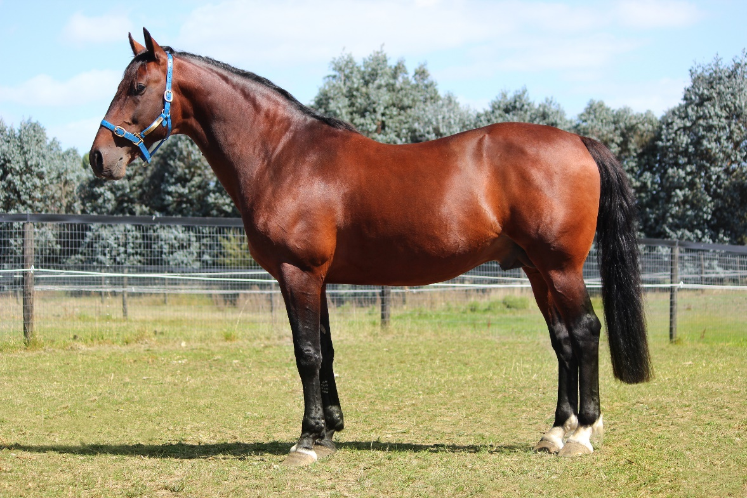
SKY MAJOR
The Jewels Legend!
His progeny, still yearlings, are impressing trainers
Has really stamped them
Served a great book last year
Service fee slashed again this season

Slide 4

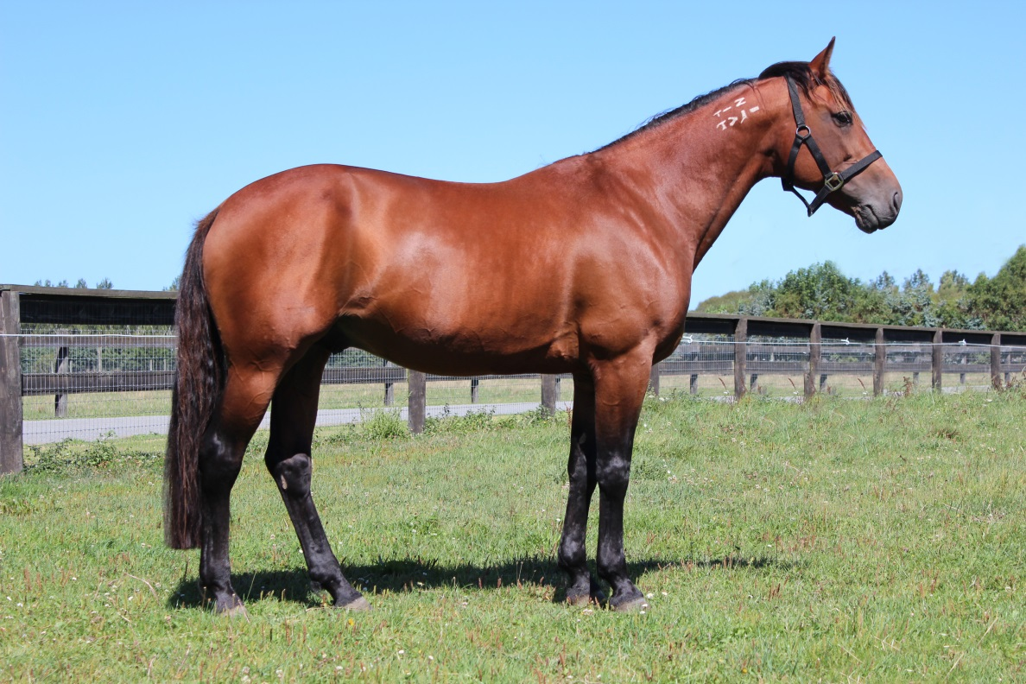
ONE OVER da moon
Sire of a dual Group winner from just 2 to race
Had 6 to race for 4 winners & 2 placegetters to-date
Impressive results from small number of mares bred

Slide 5
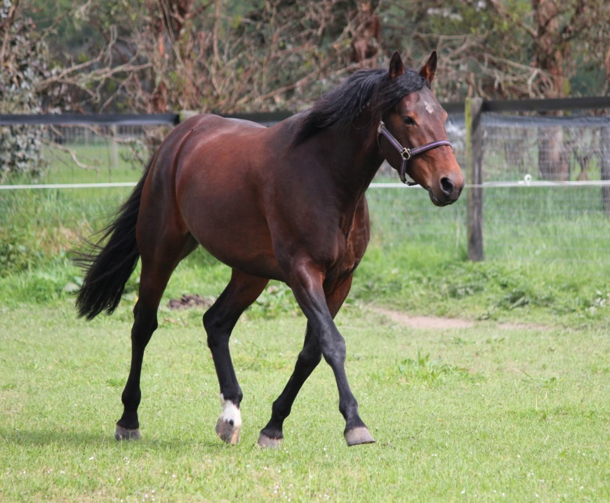
Buy KIWI MADE
First foal sired to race was the impressive Sociable – 6 wins including the Group 2 Queensland Oaks
Now has a 3yo racing – just had 2 starts to-date
Vast majority not racing age yet
Great POLF fresh stallion option

Slide 6
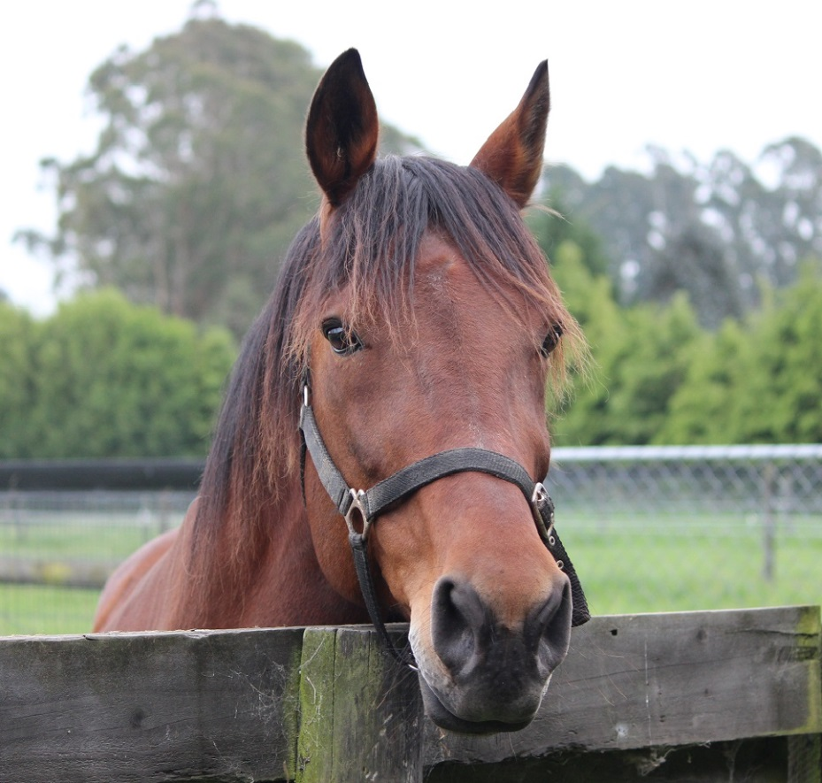
MASTER GLIDE
Doug now has 9 Australian wins
First NZ winner Miss Jessica has won 2 to-date
A small number of youngsters now qualified
Only son of Yankee Glide in Southern Hemisphere

Slide 7

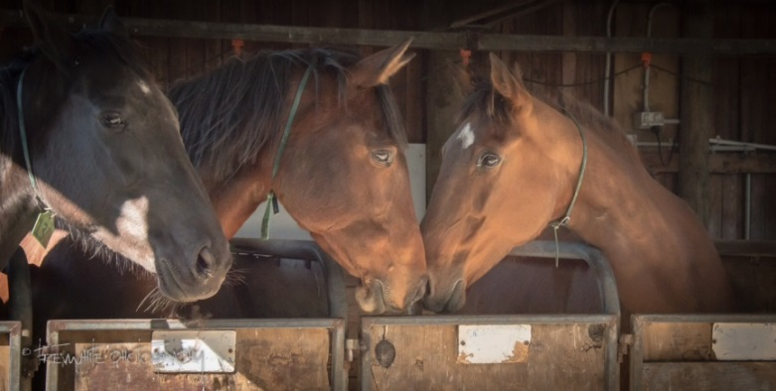

Breeding/foaling
Agistment – mares, youngstock, racehorses
PROVIDING THE BEST FOR THE BEST

